Slide 1
SCST1123 MATHEMATICS FOR SE
CHAPTER 1
SET THEORY
[Part 1: Set & Subset]
nzah@utm.my

Slide 2
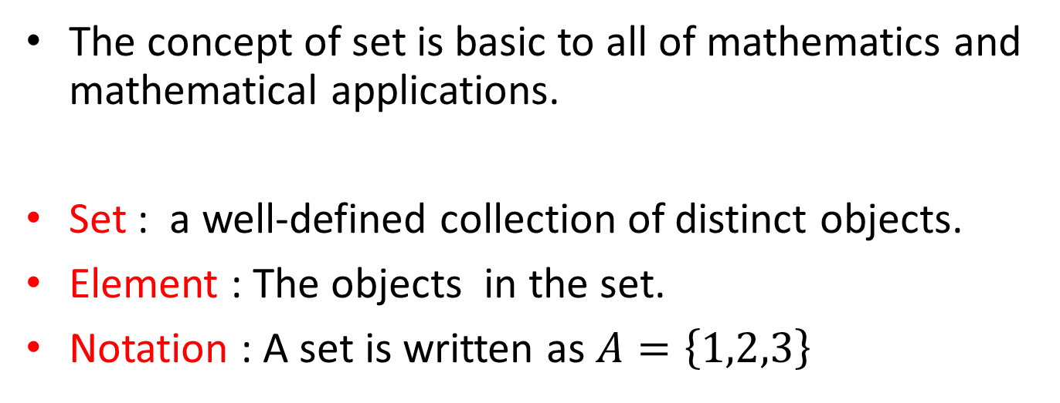
SCST1123 MATHEMATICS FOR SE
Sets
Sets
The concept of set is basic to all of mathematics and mathematical applications.
Set : a well-defined collection of distinct objects.
Element : The objects in the set.
Notation : A set is written as $A=\left\{1,2,3\right\}$
2
nzah@utm.my

Slide 3
SCST1123 MATHEMATICS FOR SE
Sets (cont’d)
Sets
Well-defined means that we can tell for certain whether an object is a member of the collection or not.
If a set is finite and not too large, we can describe it by listing the elements in it.
3
nzah@utm.my

Slide 4
SCST1123 MATHEMATICS FOR SE
Example
example
i) A is a set of all positive integers less than 10:
A = {1, 2, 3, 4, 5, 6, 7, 8, 9}
ii) B is a set of first 5 positive odd integers:
B = {1, 3, 5, 7, 9}
iii) C is a set of vowels:
C = {a, e, i, o, u}
4
nzah@utm.my

Slide 5
How we Define Sets
SCST1123 MATHEMATICS FOR SE
This can be done by:
  Listing ALL elements of the set within braces.
  Listing enough elements to show the pattern then an ellipsis.
  Use set builder notation to define “rules” for determining membership in the set.
5
nzah@utm.my

Slide 6
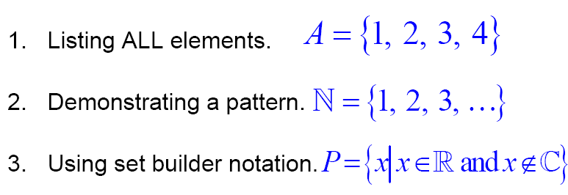
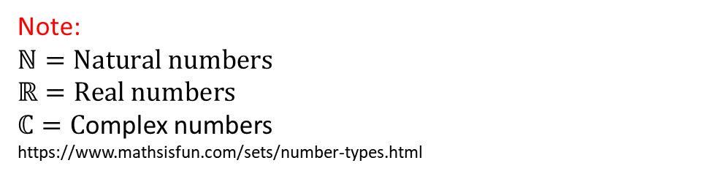
Example
SCST1123 MATHEMATICS FOR SE
Note:
$$ℕ=Natural numbers$$
$$ℝ=Real numbers$$
$ℂ=C$omplex numbers
https://www.mathsisfun.com/sets/number-types.html
6
nzah@utm.my

Slide 7
SCST1123 MATHEMATICS FOR SE
Defining Sets (cont’d)
Set (cont’d)s
A set is determined by its elements and not by any particular order in which the element might be listed.
Example:
For set A = {1, 2, 3, 4}, this set might just as well be specified as,
{2, 3, 4, 1} or {4, 1, 3, 2}
7
nzah@utm.my

Slide 8
SCST1123 MATHEMATICS FOR SE
Defining Sets (cont’d)
Sets
The elements making up a set are assumed to be distinct, we may have duplicates in our list, only one occurrence of each element is in the set.
Example:
{a, b, c, a, c} {a, b, c}
{1, 3, 3, 5, 1} {1, 3, 5}
8
nzah@utm.my

Slide 9
SCST1123 MATHEMATICS FOR SE
Defining Sets (cont’d)
Sets
Use uppercase letters A, B, C … to denote sets, lowercase denote the elements of set.
The symbol ∈ stands for ‘belongs to’
The symbol ∉ stands for ‘does not belong to’
9
nzah@utm.my

Slide 10
SCST1123 MATHEMATICS FOR SE
Example
example
X={ a, b, c, d, e }, b ∈ X and m ∉ X
A={{1}, {2}, 3, 4}, {1} ∈ A and 1 ∉ A
10
nzah@utm.my

Slide 11
SCST1123 MATHEMATICS FOR SE
Defining Sets (cont’d)
Sets
If a set is a large finite set or an infinite set, we can describe it by listing a property necessary for memberships.
Let S be a set, the notation, using set builder
A= {x | x ∈ S, P(x)} or A= {x ∈ S | P(x)}
means that A is the set of all x in S such that P of x.
11
nzah@utm.my

Slide 12
SCST1123 MATHEMATICS FOR SE
Example
example
Let A={1, 2, 3, 4, 5, 6}, we can also write A using set builder notation,
A = {x | x ∈ Z, 0 < x <7} ,
if Z denotes the set of integers.
Let B = {x | x ∈ Z, x > 0} → B = {1, 2, 3, 4, …}
12
nzah@utm.my

Slide 13
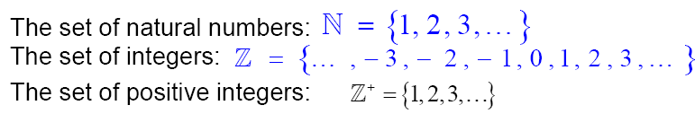
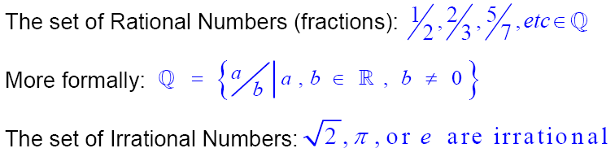

SCST1123 MATHEMATICS FOR SE
Example – Standard definition
example
The Real numbers =
13
nzah@utm.my

Slide 14
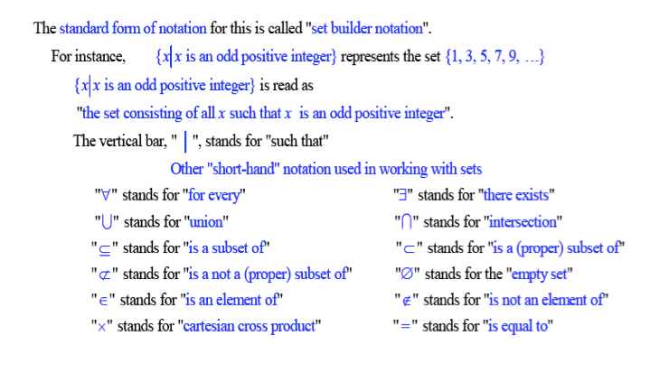
Symbols Used With Set Builder Notation
SCST1123 MATHEMATICS FOR SE
14
nzah@utm.my

Slide 15
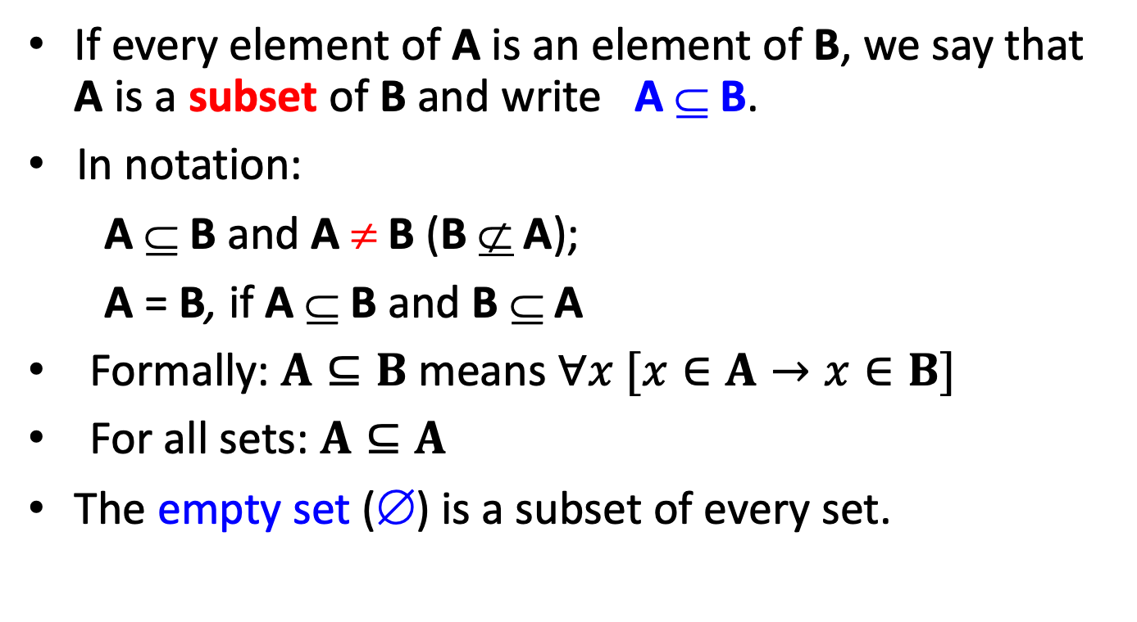
Subset [ ⊆ ]
SCST1123 MATHEMATICS FOR SE
If every element of A is an element of B, we say that A is a subset of B and write A ⊆ B.
In notation:
A ⊆ B and A ≠ B (B ⊄ A);
A = B, if A ⊆ B and B ⊆ A
Formally: $A⊆B$ means $∀x [x∈A→x∈B]$
For all sets: $A⊆A$
The empty set (∅) is a subset of every set.
15
nzah@utm.my

Slide 16
Example
SCST1123 MATHEMATICS FOR SE
Let, set A = {1, 2, 3}
The subset of A are
∅, {1}, {2}, {3}, {1, 2}, {1, 3}, {2, 3}, {1, 2, 3}
Note: A is a subset of A
16
nzah@utm.my

Slide 17

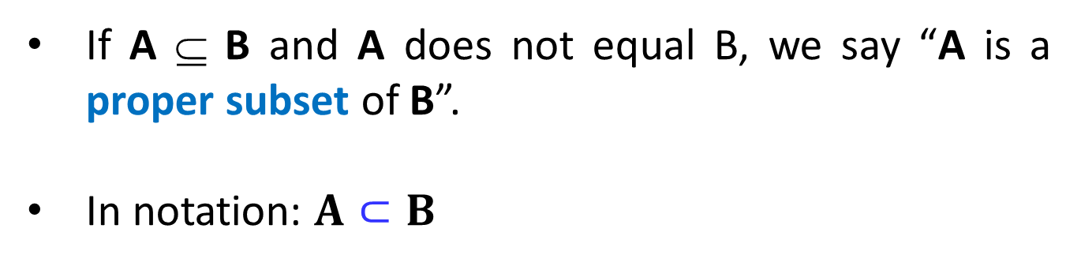
SCST1123 MATHEMATICS FOR SE
Proper Subsets [ $⊂$ ]
If A ⊆ B and A does not equal B, we say “A is a proper subset of B”.
In notation: $A⊂B$
17
nzah@utm.my

Slide 18
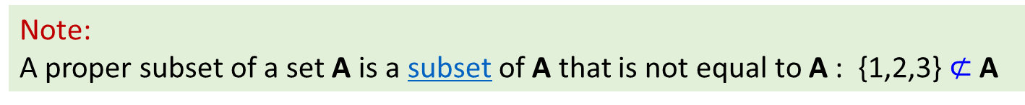
Example
SCST1123 MATHEMATICS FOR SE
A={1, 2, 3}
The proper subset of A:
∅, {1}, {2}, {3}, {1, 2}, {1, 3}, {2, 3}
Note:
A proper subset of a set A is a subset of A that is not equal to A : {1,2,3} $⊄$ A
18
nzah@utm.my

Slide 19
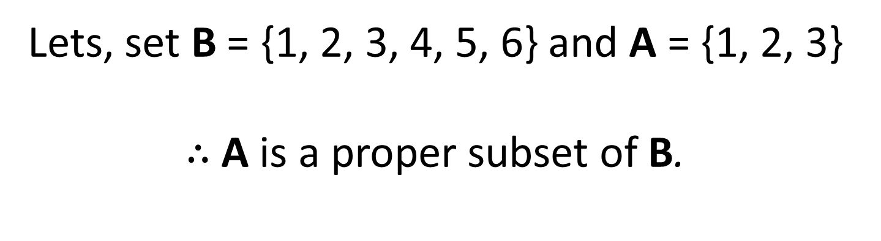
SCST1123 MATHEMATICS FOR SE
Example
Lets, set B = {1, 2, 3, 4, 5, 6} and A = {1, 2, 3}
$∴$A is a proper subset of B.
19
nzah@utm.my

Slide 20
Example
SCST1123 MATHEMATICS FOR SE
Given A = {a, b, c, d, e, f, g, h}
Which of the following subset are proper subset of A?
B = {b, d, e}
C = {a, b, c, d, e}
D = {r, s, d, e}
Ans: B and C
20
nzah@utm.my

Slide 21
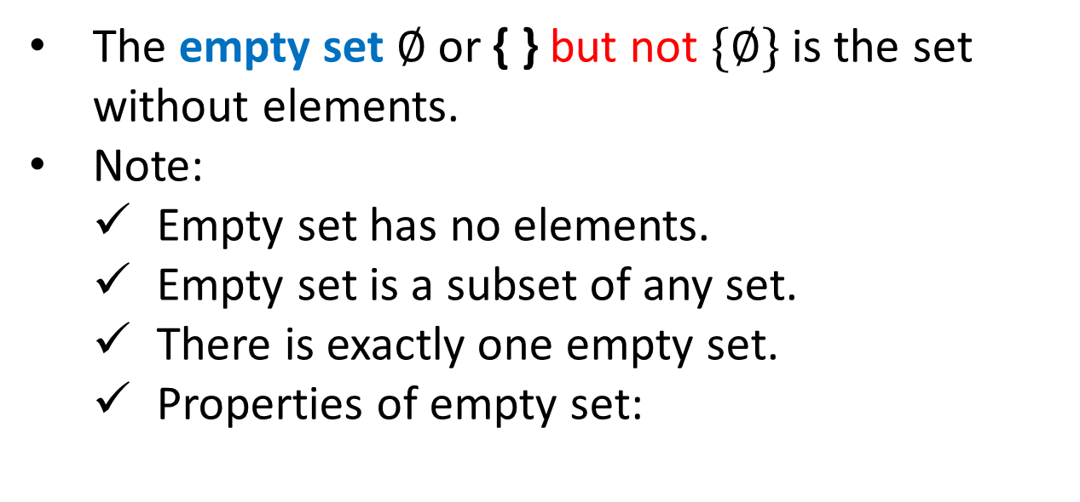

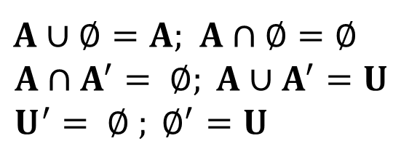
SCST1123 MATHEMATICS FOR SE
Empty Sets [ $∅$ or { } ]
The empty set $∅$or { } but not $\{∅\}$ is the set without elements.
Note:
  Empty set has no elements.
  Empty set is a subset of any set.
  There is exactly one empty set.
  Properties of empty set:
$A∪∅=A$; $A∩∅=∅$
$$A∩A^{′}= ∅; A∪A^{′}=U \\ U^{′}= ∅ ; ∅^{′}=U$$
21
nzah@utm.my

Slide 22
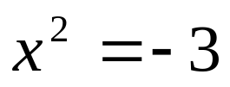
Example
SCST1123 MATHEMATICS FOR SE
i)
ii)
  = {x | x is a real number and }
  ∅ = {x | x is positive integer and x³ < 0}
22
nzah@utm.my

Slide 23
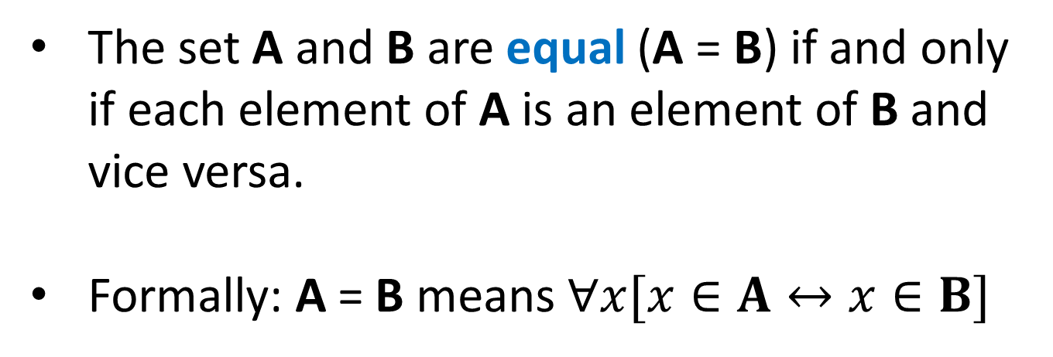

SCST1123 MATHEMATICS FOR SE
Equal Sets [ $=$ ]
The set A and B are equal (A = B) if and only if each element of A is an element of B and vice versa.
Formally: A = B means $∀x[x∈A↔x∈B]$
23
nzah@utm.my

Slide 24
Example
SCST1123 MATHEMATICS FOR SE
  i) A = {a, b, c} ; B = {b, c, a}
  ∴ A = B
  ii) C = {2, 4, 6, 8};
  D = {2x|x is a positive integer and 2x < 10}
  ∴ C = D
24
nzah@utm.my

Slide 25
SCST1123 MATHEMATICS FOR SE
Equivalent Set
Two sets, A and B are equivalent if there exists a one-to-one correspondence between them.
An equivalent set is simply a set with an equal number of elements.
Example: Lets A and B be sets.
A = {a, b, c, d, e} ; B = {1, 2, 3, 4, 5}
∴ A and B are equivalent
25
nzah@utm.my

Slide 26
SCST1123 MATHEMATICS FOR SE
Finite Set
    A set A is finite if it is empty or if there exists a nonnegative integer n such that A has n elements.
    Example: A = {1, 2, 3,…, n} ; A is called a finite set with n elements).
26
nzah@utm.my

Slide 27
Example
SCST1123 MATHEMATICS FOR SE
  Let, A and B be sets.
  A = {1, 2, 3, 4} ;
  B = {x | x is an integer, 1 < x < 4}
  ∴ A and B are finite set.
27
nzah@utm.my

Slide 28
SCST1123 MATHEMATICS FOR SE
Infinite Sets
    A set A is infinite if there is not exists a natural number n such that A is equivalent to {1, 2, 3,…, n} .
    Infinite set is uncountable.
    Are all infinite sets equivalent?
      A set is infinite if it is equivalent to a proper subset of itself!.
28
nzah@utm.my

Slide 29

Example
SCST1123 MATHEMATICS FOR SE
Lets, B, C, D, Z and S be sets.
C = {5, 6, 7, 8, 9, 10}
B = {x| x is an integer, 10 < x < 20}
D = {x| x is an integer, x > 0}
Z = {x| x is an integer} or Z = {…, -3, -2, -1, 0, 1, 2, 3,…}
S = {x| x is a real number and 1 < x < 4}
$∴$ Z and S are infinite sets
$∴C and B are finite sets;D,Z and S are infinite sets$.
29
nzah@utm.my

Slide 30
Universal Set
SCST1123 MATHEMATICS FOR SE
Sometimes we are dealing with sets all of which are subsets of a set U.
This set U is called a universal set or a universe.
The set U must be explicitly given or inferred from the context.
30
nzah@utm.my

Slide 31
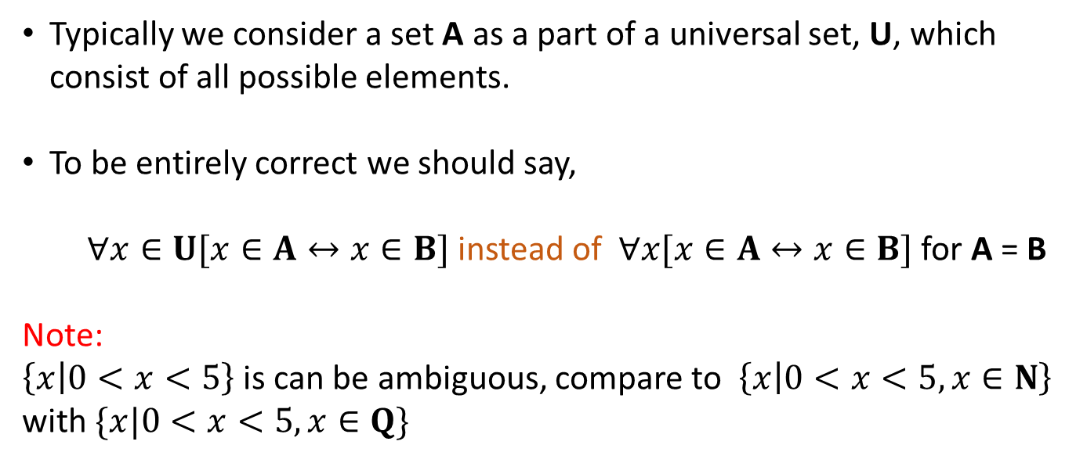
SCST1123 MATHEMATICS FOR SE
Universal Set (cont’d)
Typically we consider a set A as a part of a universal set, U, which consist of all possible elements.
To be entirely correct we should say,
$∀x∈U[x∈A↔x∈B]$ instead of $∀x[x∈A↔x∈B]$ for A = B
Note:
$\left\{x | 0<x<5\right\}$ is can be ambiguous, compare to $\left\{x | 0<x<5, x∈N\right\}$ with $\{x|0<x<5, x∈Q\}$
31
nzah@utm.my

Slide 32
Example
SCST1123 MATHEMATICS FOR SE
The sets A = {1,2,3}, B = {2,4,6,8} and C = {5,7}
One may choose U = {1,2,3,4,5,6,7,8} as a universal set.
Any superset of U can also be considered a universal set for these sets A, B, and C.
For example, U = {x | x is a positive integer}
32
nzah@utm.my

Slide 33
Cardinality of Set
SCST1123 MATHEMATICS FOR SE
Let S be a finite set with n distinct elements, where n ≥ 0.
Then we write |S|= n and say that the cardinality (or the number of elements) of S is n.
Example: A and B be sets.
A = {1, 2, 3} → |A|=3
B = {a, b, c, d, e, f, g} → |B|=7
33
nzah@utm.my

Slide 34
Power Set
SCST1123 MATHEMATICS FOR SE
The set of all subsets of a set A, denoted P(A), is called the power set of A.
P(A)= {x | x ⊆ A}
If |A|= n, then |P(A)| = 2^{n}
34
nzah@utm.my

Slide 35
Example
SCST1123 MATHEMATICS FOR SE
Lets, a set A = {1,2,3}
The power set of A,
P(A)= {∅, {1}, {2}, {3}, {1,2}, {1,3}, {2,3}, {1,2,3} }
Notice that |A| = 3, and |P(A)| = 2³ = 8
35
nzah@utm.my

Slide 36
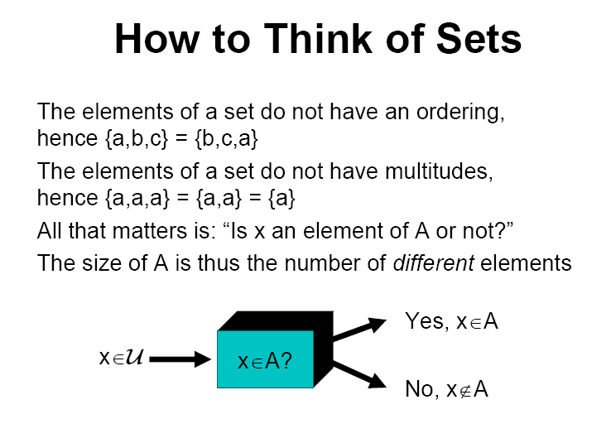
SCST1123 MATHEMATICS FOR SE
Summary
36
nzah@utm.my

Slide 37
SCST1123 MATHEMATICS FOR SE
EXERCISES
nzah@utm.my

Slide 38
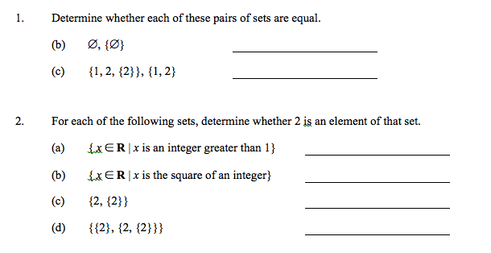
Exercise # 1
SCST1123 MATHEMATICS FOR SE
38
nzah@utm.my

Slide 39
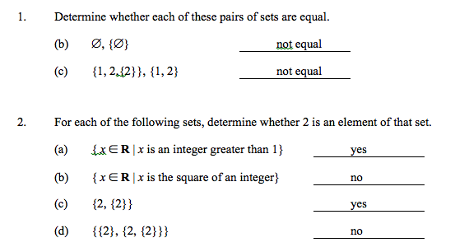
Exercise # 1 - Answer
SCST1123 MATHEMATICS FOR SE
39
nzah@utm.my

Slide 40
Exercise # 2
SCST1123 MATHEMATICS FOR SE
Determine whether each pair of sets is equal.
{1, 2, 2, 3} ; {1, 3, 2}
{ x | x ² + x = 2} ; {1, -2}
{x | x is a real number and 0 < x ≤ 2}; {1,2}
40
nzah@utm.my

Slide 41
Exercise # 2 - Answer
SCST1123 MATHEMATICS FOR SE
Determine whether each pair of sets is equal.
{1, 2, 2, 3} ; {1, 3, 2} => Equal
b) { x | x ² + x = 2} ; {1, -2} => Equal
c) {x | x is a real number and 0 < x ≤ 2}; {1,2} => Not Equal
41
nzah@utm.my

Slide 42
Exercise # 3
SCST1123 MATHEMATICS FOR SE
Let X = {0, 2, a}
Find:
  |X|
  Proper subset of X
  Power set of X
42
nzah@utm.my

Slide 43
Exercise # 3 - Answer
SCST1123 MATHEMATICS FOR SE
|X| = 3
b) Proper subset of X:
  = {∅, {0}, {2}, {a}, {0,2}, {0,a}, {2,a} }
Power set of X:
P(X) = {∅, {0}, {2}, {a}, {0,2}, {0,a}, {2,a}, {0,2,a} }
43
nzah@utm.my

Slide 44
CHAPTER 1
SCST1123 MATHEMATICS FOR SE
SET THEORY
[Part 2: Operation on Set]
nzah@utm.my

Slide 45
Union
SCST1123 MATHEMATICS FOR SE
The union of two sets A and B, denoted by A ∪ B, is defined to be the set
A ∪ B = { x | x ∈ A or x ∈ B}
The union consists of all elements belonging to either A or B (or both)
nzah@utm.my
45

Slide 46
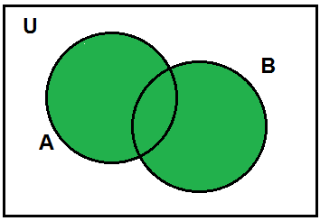
Union (cont’d)
SCST1123 MATHEMATICS FOR SE
Venn diagram of A ∪ B
A
B
If A and B are finite sets, the cardinality of A ∪ B,
| A ∪ B| = |A| + |B| − |A ∩ B|
nzah@utm.my
46

Slide 47
SCST1123 MATHEMATICS FOR SE
Example:
A = {1, 2, 3, 4, 5}; B = {2, 4, 6} and C = {8, 9}
A ∪ B = {1, 2, 3, 4, 5, 6}
A ∪ C =
{1, 2, 3, 4, 5, 8, 9}
B ∪ C =
{2, 4, 6, 8, 9}
A ∪ B ∪ C =
{1, 2, 3, 4, 5, 6, 8, 9}
nzah@utm.my
47

Slide 48
Intersection
SCST1123 MATHEMATICS FOR SE
The intersection of two sets A and B, denoted by A ∩ B, is defined to be the set
A ∩ B = { x | x ∈ A and x ∈ B}
The intersection consists of all elements belonging to both A and B.
nzah@utm.my
48

Slide 49
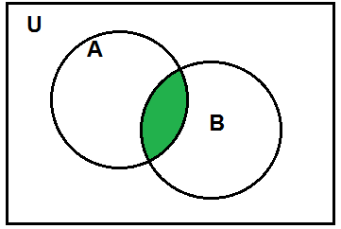
Intersection (cont’d)
SCST1123 MATHEMATICS FOR SE
Venn diagram of A ∩ B
nzah@utm.my
49

Slide 50
SCST1123 MATHEMATICS FOR SE
Example:
W = {1, 2, 3, 4, 5, 6}; X = {2, 4, 6, 8, 10} ; Y={1, 2, 8, 10}
W ∩ X =
W ∩ Y =
Y ∩ X =
W ∩ X ∩ Y =
{2, 4, 6}
{1, 2}
{2, 8, 10}
{2}
nzah@utm.my
50

Slide 51
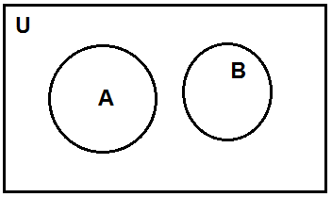
Disjoint
SCST1123 MATHEMATICS FOR SE
Two sets A and B are said to be disjoint if,
A ∩ B = ∅
Venn diagram:
nzah@utm.my
51

Slide 52

SCST1123 MATHEMATICS FOR SE
Example:
A = {1, 3, 5, 7, 9, 11}; B = {2, 4, 6, 8, 10}
$$A ∩B= ∅$$
nzah@utm.my
52

Slide 53
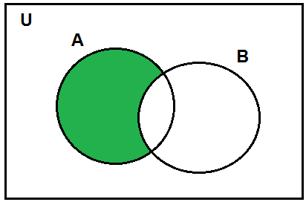
Difference
SCST1123 MATHEMATICS FOR SE
Let, A and B be sets. The difference of A minus B, denoted A − B, is the set of all elements in A that are not in B.
Formally: A− B= {x | x ∈ A and x ∉ B}
Venn diagram:
nzah@utm.my
53

Slide 54
Example:
SCST1123 MATHEMATICS FOR SE
A= {1, 2, 3, 4, 5, 6, 7, 8}; B= {2, 4, 6, 8, 9}
A− B =
B− A =
{1, 3, 5, 7}
{9}
nzah@utm.my
54

Slide 55
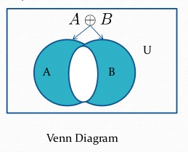
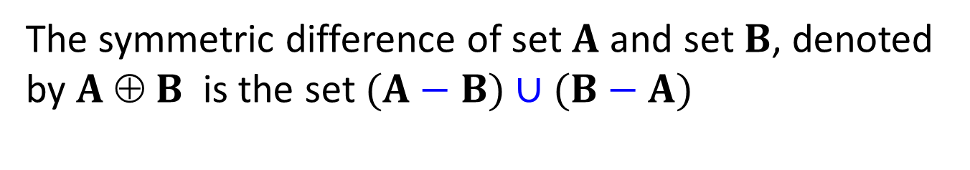
Symmetric Difference
SCST1123 MATHEMATICS FOR SE
The symmetric difference of set $A$ and set $B$, denoted by $A$ ⊕ $B$ is the set $(A−B)∪(B−A)$
nzah@utm.my

Slide 56




Example:
SCST1123 MATHEMATICS FOR SE
Let, U, A and B be sets.
$$U=\{0, 1, 2, 3, 4, 5, 6, 7, 8, 9, 10\}$$
$$A=\left\{1, 2, 3, 4, 5\right\}; B=\{4, 5, 6, 7, 8\}$$
$$A⨂B=\left(A−B\right)∪\left(B −A\right)=$$
$$\{1, 2, 3, 6, 7, 8\}$$
$$\left(B−A\right)=\{6, 7, 8\}$$
$$\left(A−B\right)=\{1, 2, 3\}$$
nzah@utm.my

Slide 57
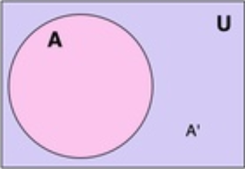
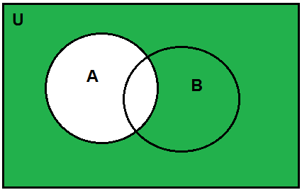
Complement
SCST1123 MATHEMATICS FOR SE
The complement of a set A with respect to a universal set U, denoted by A′ is defined to be
A′ = {x ∈U| x ∉ A}; A′ = U− A
Venn diagram:
nzah@utm.my
57

Slide 58
Example:
SCST1123 MATHEMATICS FOR SE
Let U be a universal set, and A is a subset of U.
U = { 1, 2, 3, 4, 5, 6, 7 }; A = { 2, 4, 6 }
A′ = U – A =
{ 1, 3, 5, 7 }
nzah@utm.my
58

Slide 59
Set Identities
(or Properties of Set)
SCST1123 MATHEMATICS FOR SE
Let all sets referred to below be subsets of a universal set, U.
1) Commutative laws: For all sets A and B,
a) A ∪ B = B ∪ A
b) A ∩ B = B ∩ A
nzah@utm.my
59

Slide 60
Set Identities (cont’d)
SCST1123 MATHEMATICS FOR SE
2) Associative laws: For all sets A, B and C,
a) (A ∪ B) ∪ C = A ∪ (B ∪ C)
b) (A ∩ B) ∩ C = A ∩ (B ∩ C)
nzah@utm.my
60

Slide 61
SCST1123 MATHEMATICS FOR SE
Set Identities (cont’d)
3) Distributive laws: For all sets A, B and C,
a) A ∪ (B ∩ C) = (A ∪ B) ∩ (A ∪ C)
b) A ∩ (B ∪ C) = (A ∩ B) ∪ (A ∩ C)
nzah@utm.my
61

Slide 62
Set Identities (cont’d)
SCST1123 MATHEMATICS FOR SE
4) Identity laws: For all sets A,
a) A ∪ ∅ = A
b) A ∩ U = A
5) Complement laws: For all sets A,
a) A ∪ A′ = U
b) A ∩ A′ = ∅
nzah@utm.my
62

Slide 63
Set Identities (cont’d)
SCST1123 MATHEMATICS FOR SE
6) Double Complement law: For all sets A,
(A′)′ = A
7) Idempotent laws: For all sets A,
a) A ∪ A = A
b) A ∩ A = A
8) Universal bound laws: For all sets A,
a) A ∪ U = U
b) A ∩ ∅ = ∅
nzah@utm.my
63

Slide 64
Set Identities (cont’d)
SCST1123 MATHEMATICS FOR SE
9) De Morgan’s laws: For all sets A and B,
a) (A ∪ B)′ = A′ ∩ B′
b) (A ∩ B)′ = A′ ∪ B′
10) Absorption laws: For all sets A and B,
a) A ∪ (A ∩ B) = A
b) A ∩ (A ∪ B) = A
nzah@utm.my
64

Slide 65
Set Identities (cont’d)
SCST1123 MATHEMATICS FOR SE
11) Complements of U and ∅ :
a) ∅′ = U
b) U′ = ∅
12) Set difference laws: For all sets A and B,
A-B = A ∩ B’
13) Properties of empty set. For all set A,
a) A ∪ ∅ = A
b) A ∩ ∅ = ∅
nzah@utm.my
65

Slide 66
Example:
SCST1123 MATHEMATICS FOR SE
Let A, B and C denote the subsets of a set S and let C′ denote a complement of C in S. If A ∩ C = B ∩ C and A ∩ C ′ = B ∩ C ′, then prove that A = B.
Solution:
Property (law) applied
A = A ∩ S [universal set]
= A ∩ (C ∪ C′) [complement]
= (A ∩ C) ∪ (A ∩ C′) [distributive]
= (B ∩ C) ∪ (B ∩ C′) [given conditions]
= B ∩ (C ∪ C′) [distributive law]
= B ∩ S [universal set]
= B
nzah@utm.my
66

Slide 67
Example:
SCST1123 MATHEMATICS FOR SE
Let, A and B be sets. By referring to the set identities, show that:
A - (A ∩ B) = A - B
Solution
A - (A ∩ B) = A ∩ (A ∩ B)’ [set difference laws]
= A ∩ (A’ ∪ B’) [De Morgan’s laws]
= (A ∩ A’) ∪ (A ∩ B’) [distributive laws]
= ∅ ∪ (A ∩ B’) [complement laws]
= (A ∩ B’) ∪ ∅ [commutative]
= A ∩ B’ [Identity laws]
= A - B
nzah@utm.my
67

Slide 68
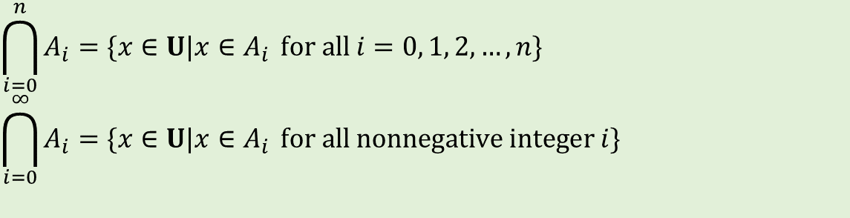

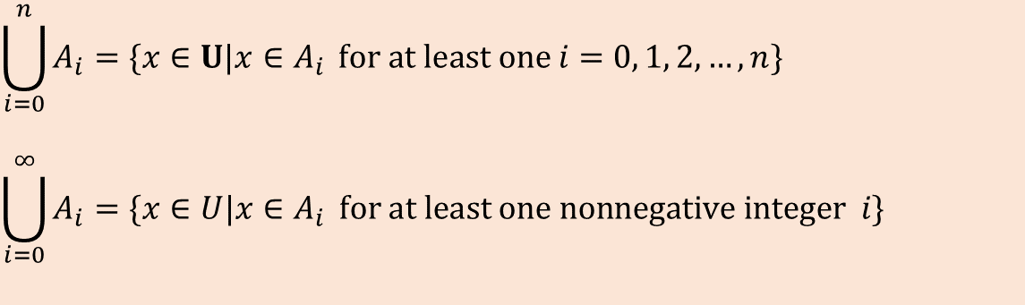
Generalized Unions & Intersection
SCST1123 MATHEMATICS FOR SE
Given sets $A_{0},A_{1},A_{2},…$ that are subsets of a universal set U and given a nonnegative integer, n.
$$\bigcup_{i=0}^{n}{A_{i}=\{x∈U|x∈A_{i } for at least one i=0, 1, 2, …,n\}}$$
$$\bigcup_{i=0}^{∞}{A_{i}=\{x∈U|x∈A_{i } for at least one nonnegative integer i\}}$$
Union
$$\bigcap_{i=0}^{n}{A_{i}=\{x∈U|x∈A_{i } for all i=0, 1, 2, …,n\}}$$
$$\bigcap_{i=0}^{∞}{A_{i}=\{x∈U|x∈A_{i } for all nonnegative integer i\}}$$
Intersection
nzah@utm.my

Slide 69
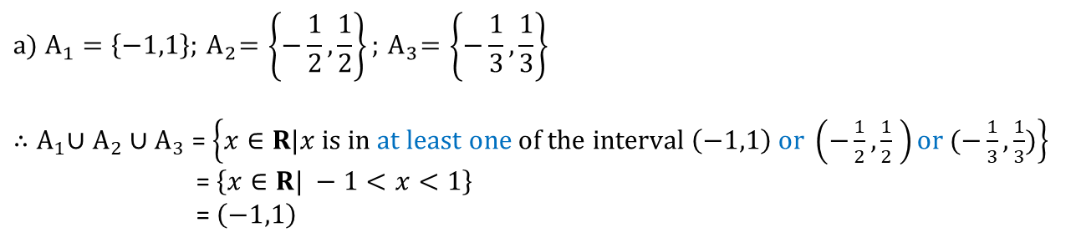
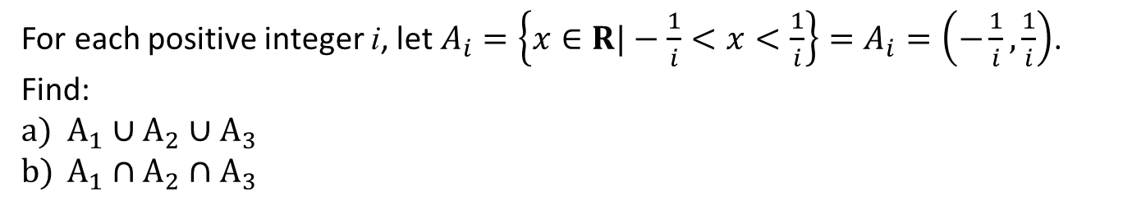
Example:
SCST1123 MATHEMATICS FOR SE
For each positive integer i, let $A_{i}=\left\{x∈R|−\frac{1}{i}<x<\frac{1}{i}\right\}=A_{i}=\left(−\frac{1}{i},\frac{1}{i}\right)$.
Find:
$A_{1}∪A_{2}∪A_{3}$
$A_{1}∩A_{2}∩A_{3}$
A1
A2
Solution (a):
A3
$${a) A}_{1}=\left\{−1,1\right\};{ A}_{2}=\left\{−\frac{1}{2},\frac{1}{2}\right\};{ A}_{3}=\left\{−\frac{1}{3},\frac{1}{3}\right\}$$
${∴A}_{1}∪A_{2}∪A_{3}$ = $\left\{x∈R|x is in at least one of the interval \left(−1,1\right) or \left(−\frac{1}{2},\frac{1}{2} \right)or (−\frac{1}{3},\frac{1}{3})\right\}$
= $\left\{x∈R| −1<x<1\right\}$
= $\left(−1,1\right)$
Because all the elements in $\left(−\frac{1}{2},\frac{1}{2} \right)and (−\frac{1}{3},\frac{1}{3})$ are in $\left(−1,1\right)$
nzah@utm.my

Slide 70
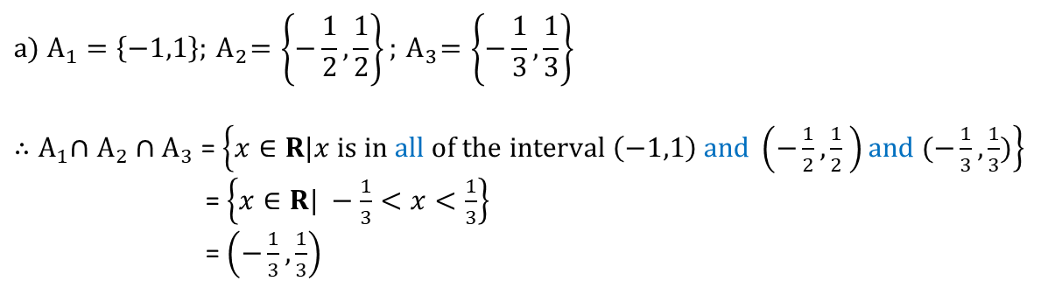

Example:
SCST1123 MATHEMATICS FOR SE
For each positive integer i, let $A_{i}=\left\{x∈R|−\frac{1}{i}<x<\frac{1}{i}\right\}=A_{i}=\left(−\frac{1}{i},\frac{1}{i}\right)$.
Find:
$A_{1}∪A_{2}∪A_{3}$
$A_{1}∩A_{2}∩A_{3}$
A1
A2
Solution (b):
A3
$${a) A}_{1}=\left\{−1,1\right\};{ A}_{2}=\left\{−\frac{1}{2},\frac{1}{2}\right\};{ A}_{3}=\left\{−\frac{1}{3},\frac{1}{3}\right\}$$
${∴A}_{1}∩A_{2}∩A_{3}$ = $\left\{x∈R|x is in all of the interval \left(−1,1\right) and \left(−\frac{1}{2},\frac{1}{2} \right)and (−\frac{1}{3},\frac{1}{3})\right\}$
= $\left\{x∈R| −\frac{1}{3}<x<\frac{1}{3}\right\}$
= $\left(−\frac{1}{3},\frac{1}{3}\right)$
Because $\left(−\frac{1}{3},\frac{1}{3} \right)⊆ (−\frac{1}{2},\frac{1}{2})⊆$ $\left(−1,1\right)$
nzah@utm.my

Slide 71
Cartesian Product
SCST1123 MATHEMATICS FOR SE
Given sets A and B, the Cartesian product of A and B, denoted A×B (read “A cross B”) is the set of all ordered pairs (a, b), where a is in A and b is in B.
Symbolically:
A×B = {(a, b)| a ∈ A and b ∈ B}
nzah@utm.my
71

Slide 72
Example:
SCST1123 MATHEMATICS FOR SE
Let, A and B be sets.
A = {a, b}; B = {1, 2}
A×B =
B×A =
{(a, 1), (a, 2), (b, 1), (b, 2)}
{(1, a), (1, b), (2, a), (2, b)}
nzah@utm.my
72

Slide 73
..Cartesian Product
SCST1123 MATHEMATICS FOR SE
Cartesian Product (cont’d)
Notation:
An ordered pair of elements a ∈ A and b ∈ B written as (a, b) is a listing of the elements a and b in a specific order.
  The ordered pair (a, b) specifies that a is the first element and b is the second element.
  An ordered pair (a, b) is considered distinct from ordered pair (b, a), unless a = b.
  Example: (1, 2) ≠ (2, 1)
nzah@utm.my
73

Slide 74
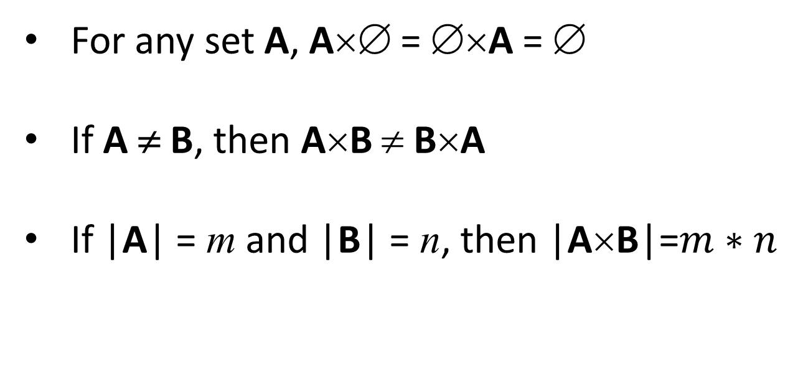
SCST1123 MATHEMATICS FOR SE
Cartesian Product (cont’d)
For any set A, A×∅ = ∅×A = ∅
If A ≠ B, then A×B ≠ B×A
If |A| = m and |B| = n, then |A×B|=$m∗n$
nzah@utm.my
74

Slide 75
SCST1123 MATHEMATICS FOR SE
Cartesian Product (cont’d)
The Cartesian product of sets A₁, A₂, …., A_{n} is defined to be the set of all n-tuples
(a₁, a₂,…a_{n}) where a_{i}∈ A_{i} for i=1,…,n;
It is denoted A₁ × A₂ × …. × A_{n}
|A₁ × A₂ × …. × A_{n} |= |A₁ |.|A₂ | …. |A_{n} |
nzah@utm.my
75

Slide 76
Example:
SCST1123 MATHEMATICS FOR SE
Let, A, B and C be sets.
A= {a, b}; B={1, 2}, C={x, y}
A×B×C = {(a,1,x), (a,1,y), (a,2,x), (a,2,y),
(b,1,x), (b,1,y), (b,2,x), (b,2,y)}
|A×B×C|= 2 * 2 * 2 = 8
nzah@utm.my
76

Slide 77
Example:
SCST1123 MATHEMATICS FOR SE
Let, C, D and E be sets.
C = {1, 3}; D = {2, 4, 6}; E = {a, b}
Find:
a) C×D = ?
b) D×C = ?
c) Is C×D = D×C ?
d) (C×D) × E = ?
e) |C×D |= ?
f) |C×D×E |= ?
nzah@utm.my
77

Slide 78
Example - Solution:
SCST1123 MATHEMATICS FOR SE
a) C×D = {(1, 2), (1, 4), (1, 6), (3, 2), (3, 4), (3, 6)}
b) D×A = {(2, 1), (2, 3), (4, 1), (4, 3), (6, 1), (6, 3)}
c) Since C ≠ D, therefore C×D ≠ D×C
d) (C×D) × E = {((1, 2), a), ((1, 4), a), ((1, 6), a), ((3, 2), a), ((3, 4), a), ((3, 6), a),
((1, 2), b), ((1, 4), b), ((1, 6), b), ((3, 2), b), ((3, 4), b), ((3, 6), b)}
e) |C| = 2 , |D| = 3, | C×D |= 2*3= 6
f) |C×D ×E |= 6*2= 12
nzah@utm.my
78

Slide 79
SCST1123 MATHEMATICS FOR SE
EXERCISES
nzah@utm.my

Slide 80
Exercise #1
SCST1123 MATHEMATICS FOR SE
Given sets,
U = { a, b, c, d, e, f , g, h, i, j, k, l, m }
A = { a, c, f, m}
B = { b, c, g, h, m }
Find:
  A ∪ B
  A ∩ B
  |A ∪ B|
  A − B
  A′
nzah@utm.my
80

Slide 81
Exercise #1: Solution
SCST1123 MATHEMATICS FOR SE
Given sets,
U = { a, b, c, d, e, f , g, h, i, j, k, l, m }
A = { a, c, f, m}
B = { b, c, g, h, m }
Find:
  A ∪ B = {a, c, f, m, b, g, h}
  A ∩ B = {c, m }
  |A ∪ B| = 7
  A − B = {a, f}
  A′= U – A = {b, d, e, g, h, i, j, k, l}
nzah@utm.my
81

Slide 82
Exercise #2
SCST1123 MATHEMATICS FOR SE
Let the universal set, U={1, 2, 3, 4,…..,10}.
Let a set A={1, 4, 7, 10}, B={1, 2, 3, 4, 5} and C={2, 4, 6, 8}
List the elements of each set:
U′
B′∩ (C−A)
(A ∪ B) ∪ (C − B)
(A∩ B) ∪ (B − C)
nzah@utm.my
82

Slide 83
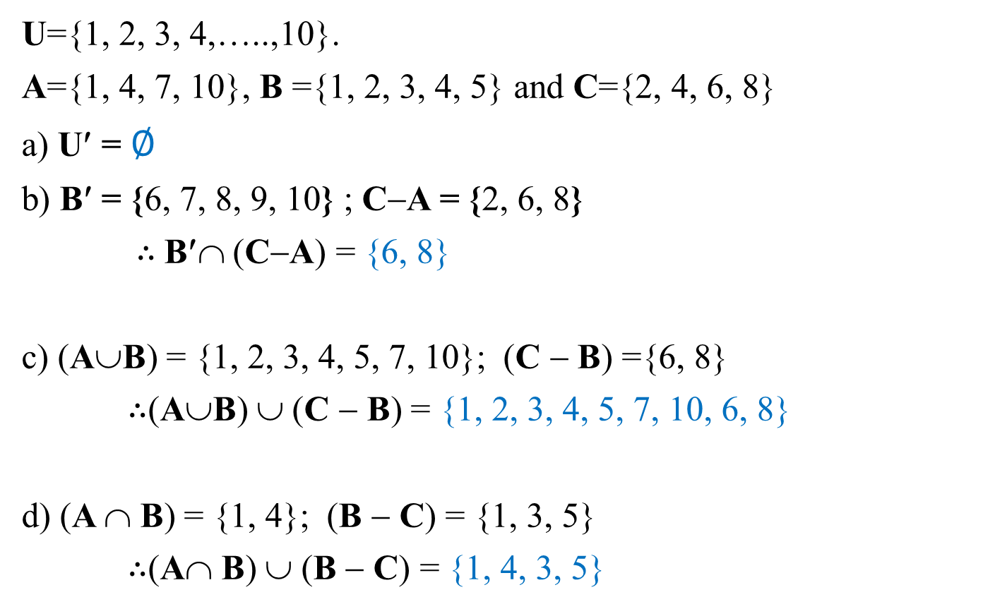
Exercise #2 - Solution
SCST1123 MATHEMATICS FOR SE
U={1, 2, 3, 4,…..,10}.
A={1, 4, 7, 10}, B ={1, 2, 3, 4, 5} and C={2, 4, 6, 8}
U′ = ∅
B′ = {6, 7, 8, 9, 10} ; C−A = {2, 6, 8}
$∴$B′∩ (C−A) = {6, 8}
c) (A∪B) = {1, 2, 3, 4, 5, 7, 10}; (C − B) ={6, 8}
$∴$(A∪B) ∪ (C − B) = {1, 2, 3, 4, 5, 7, 10, 6, 8}
d) (A ∩ B) = {1, 4}; (B − C) = {1, 3, 5}
$∴$(A∩ B) ∪ (B − C) = {1, 4, 3, 5}
nzah@utm.my
83

Slide 84
SCST1123 MATHEMATICS FOR SE
Exercise #3
Let A, B and C be sets such that
A ∩ B = A ∩ C and A ∪ B = A ∪ C
Prove that B = C
nzah@utm.my
84

Slide 85
SCST1123 MATHEMATICS FOR SE
Exercise #3 - Solution
Given: A ∩ B = A ∩ C and A ∪ B = A ∪ C
B = B ∩ (B ∪ A) [Absorption ]
= B ∩ (A ∪ B) [commutative]
= B ∩ (A ∪ C) given conditions
= (B ∩ A) ∪ (B ∩ C) [distributive]
= (A ∩ B) ∪ (B ∩ C) [commutative]
= (A ∩ C) ∪ (B ∩ C) given conditions
= (C ∩ A) ∪ (C ∩ B) [commutative]
= C ∩ (A ∪ B) [distributive]
= C ∩ (A ∪ C) given conditions
= C ∩ (C ∪ A) [commutative]
= C [Absorption ]
nzah@utm.my
85

Slide 86
Exercise #4
SCST1123 MATHEMATICS FOR SE
Given sets A= {w, x}; B={1, 2} and C={KB, SD, PS}.
a) Determine the following set,
  A×B
  B×C
  A×C
  iv) A×B×C
  v) (B×C)×A
  vi) A×B× (A×C)
  b) Find:
    |A×B|
    |B×C|
    |A×C|
    |A×B×C|
    |B×C×A|
    |A×B×A×C|
nzah@utm.my
86

Slide 87
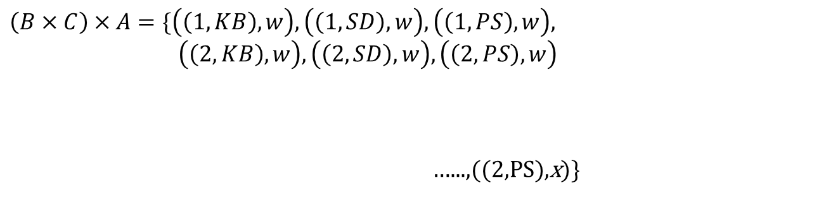
SCST1123 MATHEMATICS FOR SE
Exercise #4a(v) - Solution
A= {w, x}; B={1, 2} and C={KB, SD, PS}.
(B×C)×A = ?
$$B×C=\{\left(1,KB\right), \left(1,SD\right), \left(1,PS\right), \left(2, KB\right), \left(2, SD\right), \left(2,PS\right)\}$$
$$\left(B×C\right)×A=\{\left(\left(1,KB\right),w\right), \left(\left(1, SD\right),w\right), \left(\left(1,PS\right),w\right),$$
$\left(\left(2,KB\right),w\right), \left(\left(2, SD\right),w\right), \left(\left(2,PS\right),w\right)$
…...,((2,PS),x)}
|(B×C)×A| =(2*3)*2 = 12
nzah@utm.my

Slide 88
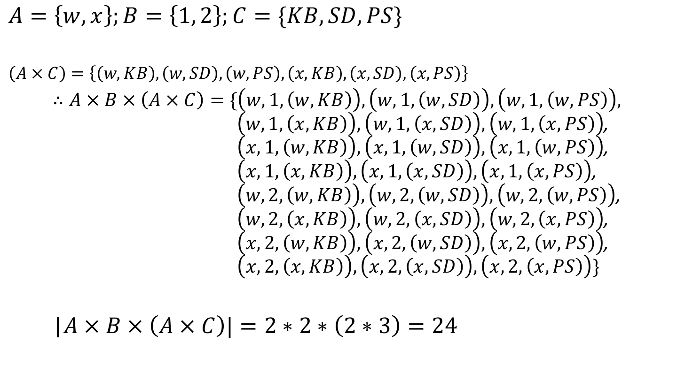
Exercise #4a(vi) - Solution
SCST1123 MATHEMATICS FOR SE
$$A=\left\{w,x\right\};B=\left\{1, 2\right\};C=\{KB, SD, PS\}$$
$$\left(A×C\right)=\left\{\left(w,KB\right), \left(w, SD\right), \left(w,PS\right),\left(x,KB\right), \left(x, SD\right), \left(x,PS\right)\right\}$$
  $∴A×B×\left(A×C\right)=\{\left(w,1,\left(w,KB\right)\right), \left(w,1, \left(w,SD\right)\right), \left(w,1,\left(w,PS\right)\right),$ $\left(w,1,\left(x,KB\right)\right), \left(w,1, \left(x,SD\right)\right), \left(w,1,\left(x,PS\right)\right)$, $\left(x,1,\left(w,KB\right)\right), \left(x,1, \left(w,SD\right)\right), \left(x,1,\left(w,PS\right)\right)$,$\left(x,1,\left(x,KB\right)\right), \left(x,1, \left(x,SD\right)\right), \left(x,1,\left(x,PS\right)\right)$, $\left(w,2,\left(w,KB\right)\right), \left(w,2, \left(w,SD\right)\right), \left(w,2,\left(w,PS\right)\right)$, $\left(w,2,\left(x,KB\right)\right), \left(w,2, \left(x,SD\right)\right), \left(w,2,\left(x,PS\right)\right)$, $\left(x,2,\left(w,KB\right)\right), \left(x,2, \left(w,SD\right)\right), \left(x,2,\left(w,PS\right)\right)$,$\left(x,2,\left(x,KB\right)\right), \left(x,2, \left(x,SD\right)\right), \left(x,2,\left(x,PS\right)\right)\}$
  |$A×B×\left(A×C\right)|=2∗2∗\left(2∗3\right)=24$
nzah@utm.my
88

